Slide 1
Investigating Volatility Risk Premium in Short-Dated BTC Options
H. Huang | H. Sodhi | A. Neo | S. Huang | I. Karthik

Slide 2
Motivation
Literature Review
Data
Model
Results
Conclusion and Improvements

Slide 3
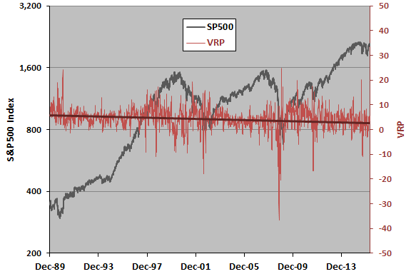
Motivation
Core question: "Do BTC options systematically misprice volatility, and does this vary by day of the week?”
Volatility Risk Premium
Cryptocurrency is Structurally Interesting
Volatility Risk Premium (VRP) approximated by implied variance (IV) – realized variance (RV) over matching horizon
VRP well-documented in equity markets with IV > RV to compensate for bearing tail risk
Existence of VRP may be exploited and traded via short straddles / strangles
24/7 live trading— no overnight gap, no market close
Weekend sessions are live trading periods, not just time decay
Retail-dominated weekends vs institutional weekdays creates potential microstructure differences
BTC Daily Options are New and Understudied
BTC daily options are a new and understudied instrument only introduced in Derebit in 2021
Short time-to-expiry options allows for investigation of day-of-week calendar effects in VRP

Slide 4
Literature Review
VRP Existence Research Papers
Day of Week Effects in BTC
Carr & Wu (2009)
Documents that delta-hedged option positions generate negative returns
Caporale & Plastun (2019)
Documents a day-of-the-week effect in cryptocurrency markets.
Ma & Tanizaki (2019)
Show that BTC volatility is highest on Mondays, and that day-of-week effects in returns vary with the sample period.
BTC VRP Research
Almeida et al. (2024)
Results of 14% VRP in monthly BTC Options compared to 2% VRP in SPX

Slide 5
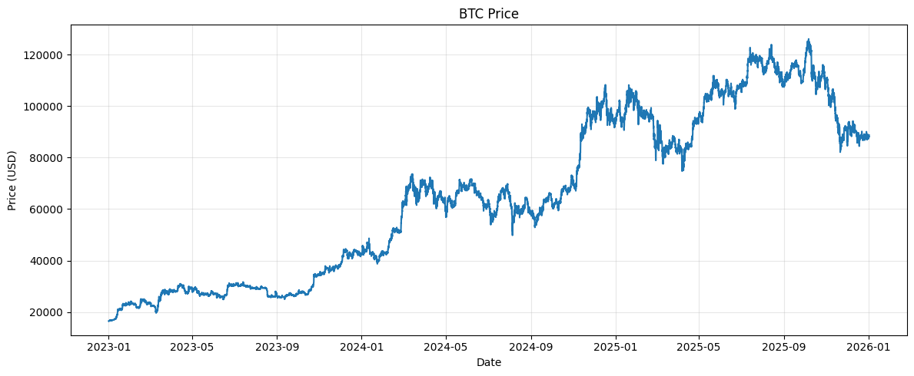
Data Acquisition
BTC Underlying Data
Options Data
Underlying Hourly BTC Data from Coinbase
Period: January 2023 to December 2025
Options Data from Derebit
Period: January 2023 to December 2025
For each day, at session open (08:00 UTC), four legs identified from the first two hours
- ATM call and put (strike closest to spot)
- OTM call (strike closest to 115% of spot)
- OTM put (strike closest to 85% of spot)
All options expire at 08:00 UTC the following day (Deribit daily expiries)
Entry price taken from nearest trade to 08:00 UTC within 2h window
Data quality filter: legs where nearest trade > 2h from open excluded

Slide 6
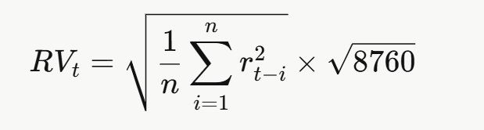
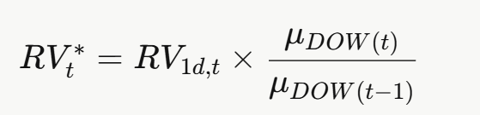
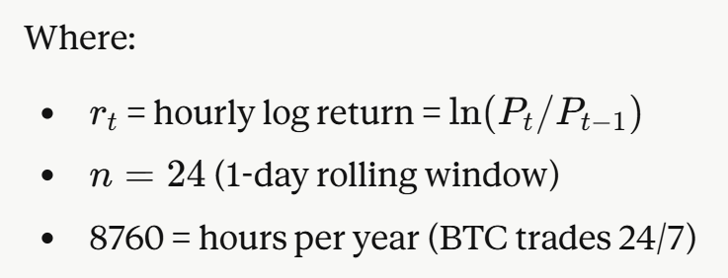
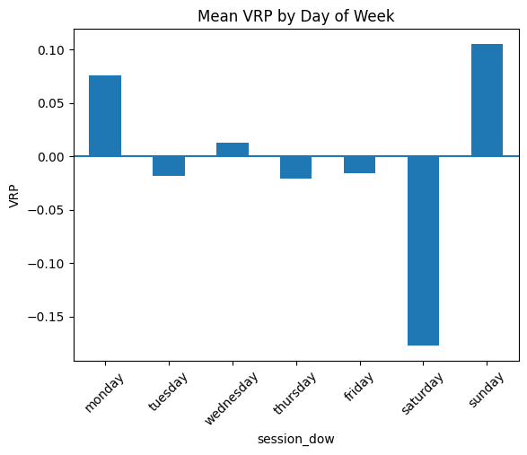
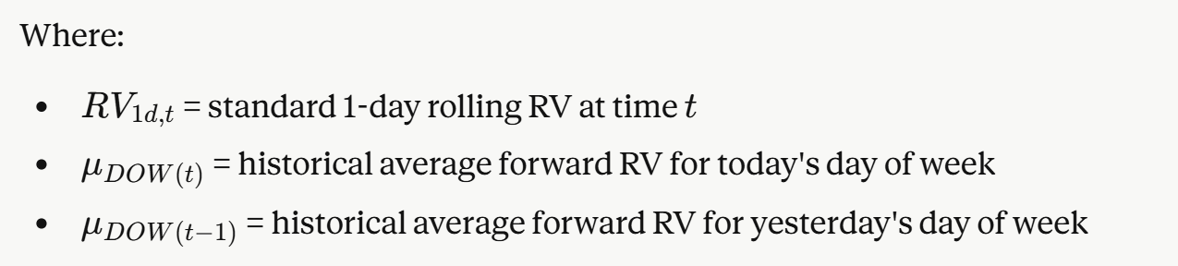
Model for RV
Rolling RV
DOW-adjusted RV

Slide 7
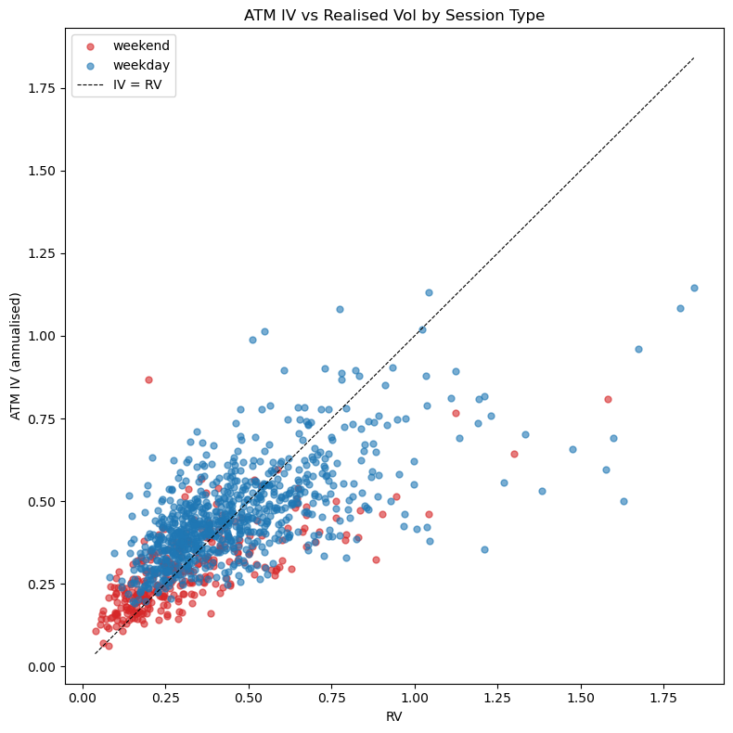
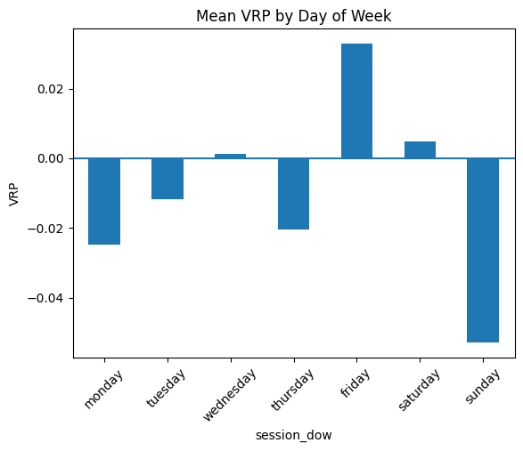
VRP Results
Day of Week | Mean VRP | t | p | n
Monday | -0.0249 | -1.67 | 0.096 | 158
Tuesday | -0.0117 | -0.84 | 0.401 | 157
Wednesday | 0.0012 | 0.08 | 0.939 | 158
Thursday | -0.0205 | -1.32 | 0.189 | 158
Friday | 0.0329 | 2.68 | 0.008 | 157
Saturday | 0.0048 | 0.61 | 0.541 | 156
Sunday | -0.0529 | -3.73 | 0.000 | 157

Slide 8







Trading Strategy
Signal Generation
Trading Strategy 1
We make an estimate of VRP, $\hat{VRP}$, as
where
and
We then calculate a VRP z-score using the 30-day rolling mean and standard deviation
We conduct a short iron butterfly trade when $z_{VRP}>1$ and a long straddle trade when $z_{VRP}<−1$.
$$\hat{VRP_{t}}=σ_{imp}−{\hat{σ}}_{realised, t}$$
$$σ_{imp}=0.5\left(σ_{imp, ATM call}+σ_{imp, ATM put}\right)$$
 | Short Trade | Long Trade
Trade Count | 113 | 147
Trade Freq | 10.3% | 13.4%
$${\hat{σ}}_{realised}=σ_{1d, t}×\frac{μ_{DOW,t}}{μ_{DOW,t−1}}$$
Trading Strategy 2
We conduct a short iron butterfly trade when $\hat{VRP}>0.05$ and $IV rank>0.4$ and a long straddle trade when $\hat{VRP}<−0.05$ and $IV rank<0.6$
$$z_{VRP}=\frac{VRP−μ_{VRP, 30d}}{σ_{VRP,30d}}$$
 | Short Trade | Long Trade
Trade Count | 99 | 314
Trade Freq | 9.0% | 28.6%

Slide 9
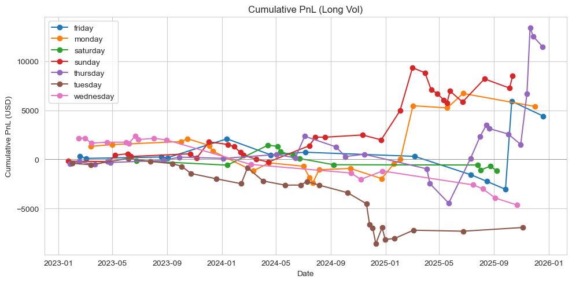
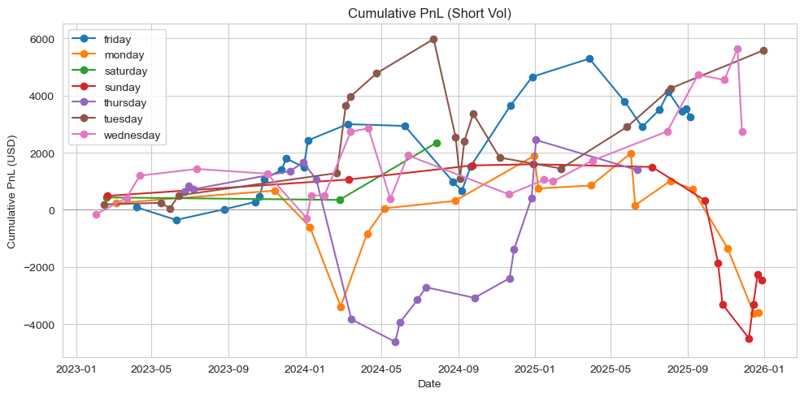
Strategy Results
 | Sharpe Ratio | Average PNL per trade ($) | Win Rate
Long Strategy | 0.53 | 116 | 37%
Short Strategy | 0.47 | 82 | 62%
Day of Week | Sharpe Ratio (Long Strategy) | Sharpe Ratio (Short Strategy)
Monday | 1.23 | -1.03
Tuesday | -2.21 | 1.64
Wednesday | -1.90 | 0.72
Thursday | 1.47 | 0.39
Friday | 0.88 | 1.12
Saturday | -0.94 | 5.19
Sunday | 1.55 | -1.38

Slide 10
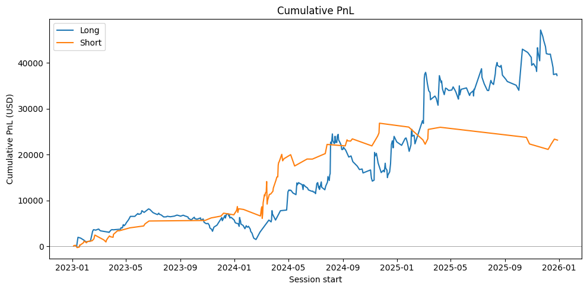
Strategy 2 Results
 | Sharpe Ratio | Average PNL per trade ($) | Win Rate
Long Strategy | 0.852 | 119 | 42%
Short Strategy | 1.18 | 234 | 70%
Day of Week | Sharpe Ratio (Long Strategy) | Sharpe Ratio (Short Strategy)
Monday | 0.47 | 2.72
Tuesday | -1.62 | 5.62
Wednesday | 0.42 | 1.76
Thursday | 1.42 | -0.74
Friday | 0.10 | 1.92
Saturday | -0.41 | 4.32
Sunday | 2.04 | -1.58

Slide 11
Improvements
Data Quality
Optimizing IV and RV metric
Currently, spot BTC closing prices were obtained at hourly intervals
Increasing frequency of data obtained, as well as intra-interval high and low prices provides more accurate volatility measurements
Options data obtained from trades within short entry window and limited to identified legs, may be extended to incorporate options chain
IV extracted directly from ATM options, use order book statistics
Volatility skew effects may be investigated at a range of ITM and OTM options
RV forecasting may be improved by considering longer-term persistent effects, such as through the use of a heterogeneous autoregressive (HAR) RV model
Exploring trading ideas
Extending Scope of Analysis
VRP currently traded via simple straddle and butterfly strategies
Dynamic Position sizing
Paired days ideas
Could combine other avenues of directional/volatility analysis

